Slide 1
Eric Prebys
Joint University-Fermilab Doctoral Program in Accelerator Physics and Related Technology

Slide 2
Fermilab Accelerator PhD Program
Started in 1985 by Leon Lederman* in response to diminishing number of students going into the field.
A student works with an advisor at his or her home institution and a local advisor at Fermilab.
After completing the formal course requirements at the home institution, the student comes to the lab to work on thesis research.
Fermilab pays for tuition, stipend, and housing allowance.
Degree is granted by home institution.
Fermilab PhD Committee regularly reviews progress.
*Nobel laureate and former director of FNAL
Fermilab Joint Accelerator PhD program

Slide 3
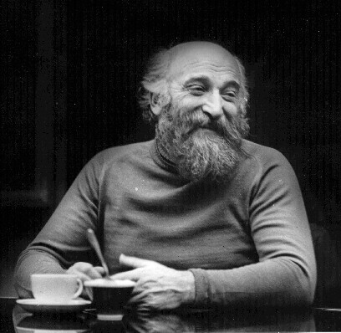
Budker Seminars
The PhD program hosts monthly “Budker Seminars” for students, advisors, and anyone else who’s interested.
About once a year, each student makes a short, informal presentation on his or her work, to let us know what they’re doing and to get feedback.
Pizza and beer provided.
Gersh Itskovich Budker
(1918-1977)
  Collective instabilities
  Colliding beams
  Electron cooling
  Exponential neutrino horns
  Nuclear fusion confinement
  Education
  A really cool beard!!
  Much, much more
Fermilab Joint Accelerator PhD program

Slide 4
Graduates (not quite up to date)
Denise Ford (Northwestern) 2013
Arun Saini (Delhi) 2012
Tim Maxwell (NIU) 2012
W-M. Tam (Indiana) 2010
Dan McCarron (IIT) 2010
Uros Mavric (Ljubljana) 2009
Tim Koeth (Rutgers) 2009
Ryoichi Miyamoto (UT Austin) 2008
Alexi Poklonsky (Michigan State) 2008
Phill Yoon (Rochester) 2007
Pavel Snopok (Michigan State) 2007
Berbardo Bordini (Pisa) 2006
Xiaobiao Huang (Indiana) 2005
Robert Zwaska (UT Austin) 2005
Kip Bishofberger (UCLA) 2005
Sergey Seletskiy (Rochester) 2005
Ludovic Nicolas (Glasgow) 2005
Mohammad Alsharoa (IIT) 2005
Linda Imbasciati (Vienna) 2003
Vadim Kashikhin (SRIEA, Russia) 2002
Vincent Wu (Cincinnati) 2001
Jean-Paul Carneiro (U. of Paris) 2001
Michael Fitch (Rochester) 2000
Oleg Krivosheev (TPU, Russia) 1998
Katya Langen (Wisconsin) 1997
Eric Colby (UCLA) 1997
Linda Spentzouris (Northwestern) 1996
David Olivieri (Massachusetts) 1996
Ping Jung Chou (Northwestern) 1995
Donna Siergiej (New Mexico) 1995
Xianping Lu (Colorado) 1994
Bill Graves (Wisconsin) 1994
Kathy Harkay (Purdue) 1993
Ping Zhou (Northwestern) 1993
Todd Satogata (Northwestern) 1993
John Palkovic (Wisconsin) 1991
Pilei Zhang (Houston) 1991
Xiao-qing Wang (IIT) 1991
Mark Stahl (Northwestern) 1991
Leonid Sagalofsky (Illinois) 1989
Lia Merminga (Michigan) 1989
Mike Syphers (Illinois - Chicago) 1987
  First graduate
  Co-wrote textbook with adviser D. Edwards
Fermilab Joint Accelerator PhD program

Slide 5
For more information
Joint PhD program
  http://phd.fnal.gov/
Or contact me
  prebys@fnal.gov
  http://home.fnal.gov/~prebys/
Fermilab Joint Accelerator PhD program

